Slide 1

“portfolio website”
Task - 2

Slide 2
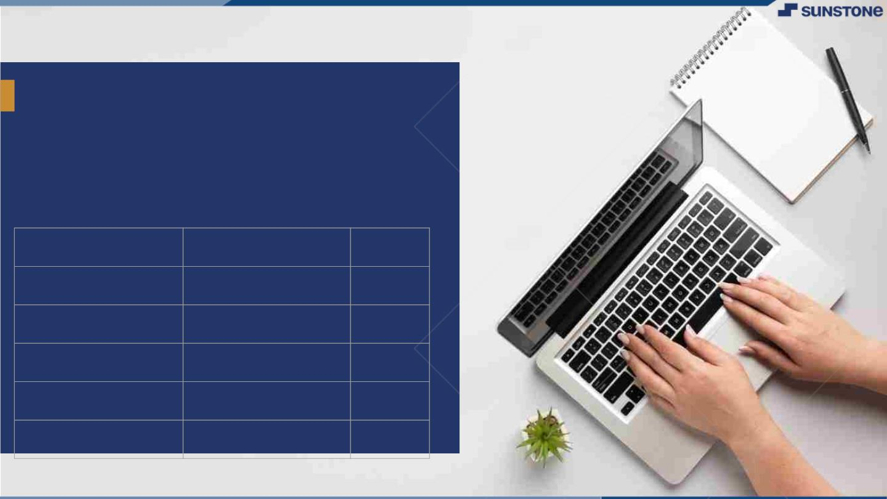
YourꢀProjectꢀName
▪
YourꢀProjectꢀIntroduction
LMS Username | Name | Batch
au310520104036 | B.Gokul krishnan | 07
au310520104042 | S.Jayaprakash | 07
au310520104039 | G.Hariharan | 07
au310520104130 | K.S.surya | 07
LMS Username
Name
Batch

Slide 3

Taskꢀ-ꢀ2
CreateꢀUIꢀandꢀimplementꢀvariousꢀcomponentsꢀusingꢀreact
●
●
●
SplitꢀdesignꢀintoꢀcomponentsꢀandꢀHigherꢀorderꢀComponents
Defineꢀstructureꢀofꢀtheꢀcomponents
Setꢀtheꢀbasicꢀuiꢀcomponentsꢀwithꢀdummyꢀdata
IntegrateꢀtheꢀAPIsꢀtoꢀfrontendꢀtoꢀensureꢀtheꢀdynamicꢀfeatureꢀofꢀwebsite
●
●
●
●
●
Pointꢀbaseꢀapiꢀtoꢀtheꢀseversꢀbaseꢀurlꢀ
Designꢀapiꢀcallsꢀforꢀeachꢀelementꢀ
Handleꢀerrorsꢀinꢀtheꢀoutput
Renderꢀoutputꢀofꢀapisꢀtoꢀdifferentꢀlowꢀlevelꢀcomponents
Secureꢀcontentꢀofꢀpostꢀapisx
EvaluationꢀMetric:
● 100%ꢀCompletionꢀofꢀtheꢀaboveꢀtasks
Learning Outcome
▪
▪
▪
▪
DevelopingꢀcomplicatedꢀUIꢀusingꢀreactꢀcomponents
Usingꢀpropsꢀdrillingꢀandꢀcontextꢀtoꢀpassꢀvariables
Gettingꢀfamiliarꢀwithꢀdifferentꢀtypeꢀofꢀapiꢀcalls
Handlingꢀdifferentꢀinputꢀdata

Slide 4

Create UI and implement using react
Folder Structure:
Src
- components
- Header.js
- AboutMe.js
- Portfolio.js
- Contact.js
- Footer.js
- App.js
- index.js
- styles.css

Slide 5
Component Definitions:
Header Component (Header.js):
import React from 'react';
const Header = () => (
<header>
<h1>Your Name</h1>
<nav
> <ul
> <li>Home</li>
<li>About</li>
<li>Portfolio</li>
<li>Contact</li>
</ul>
</nav>
</header>
);

Slide 6
AboutMe.js:
import React from 'react‘;
const AboutMe = () => (
<section id="about">
<h2>About Me</h2>
<p>Your introduction and information about yourself.</p>
</section>
);
export default AboutMe;

Slide 7
Portfolio.js:
import React from 'react';
const Portfolio = () => (
<section id="portfolio">
<h2>Portfolio</h2>
{/* Your portfolio items go here */}
</section>
);
export default Portfolio;

Slide 8
Contact.js
import React from 'react';
const Contact = () => (
<section id="contact">
<h2>Contact</h2> {
/* Your contact information or a contact form goes here */}
</section>
);
export default Contact;

Slide 9
Footer.js:
import React from 'react';
const Footer = () => (
<footer>
<p>&copy; 2023 Your Name. All rights reserved.</p> </footer>
);
export default Footer;

Slide 10
App Component (App.js):
// App.js
import React from 'react';
import Header from './components/Header';
import AboutMe from './components/AboutMe';
import Portfolio from './components/Portfolio';
import Contact from './components/Contact';
import Footer from './components/Footer';
import './styles.css';
function App() {
return (
<div>
<Header />
<main>
<AboutMe />
<Portfolio />
<Contact />
</main>
<Footer />
</div>
);
}
export default App;

Slide 11
Index.js:
Make sure the index.js file in the src folder remains as generated by Create React App.

Slide 12
Styling:
/* styles.css */
body {
margin: 0;
font-family: 'Arial', sans-serif;
}
header {
background-color: #333;
color: white;
padding: 1rem;
}
nav ul {
list-style: none;
display: flex;
}
nav li {
margin-right: 1rem;
cursor: pointer;
}
section {
margin: 2rem 0;
}
footer {
background-color: #333;
color: white;
padding: 1rem;
text-align: center;
}

Slide 13
Run the App:
In the terminal, run:
bashCopy code
npm start
This will start your React development server, and you can view your portfolio at http://localhost:3000 in your web browser.
This is a basic starting point. Customize and expand these components to include your actual portfolio content and styling. You might also want to explore additional libraries for styling, state management, and routing based on your needs.

Slide 14

Submission Github
. https://github.com/jayaprakesh2002/NM-DSCET-7

Slide 15


